Slide 1
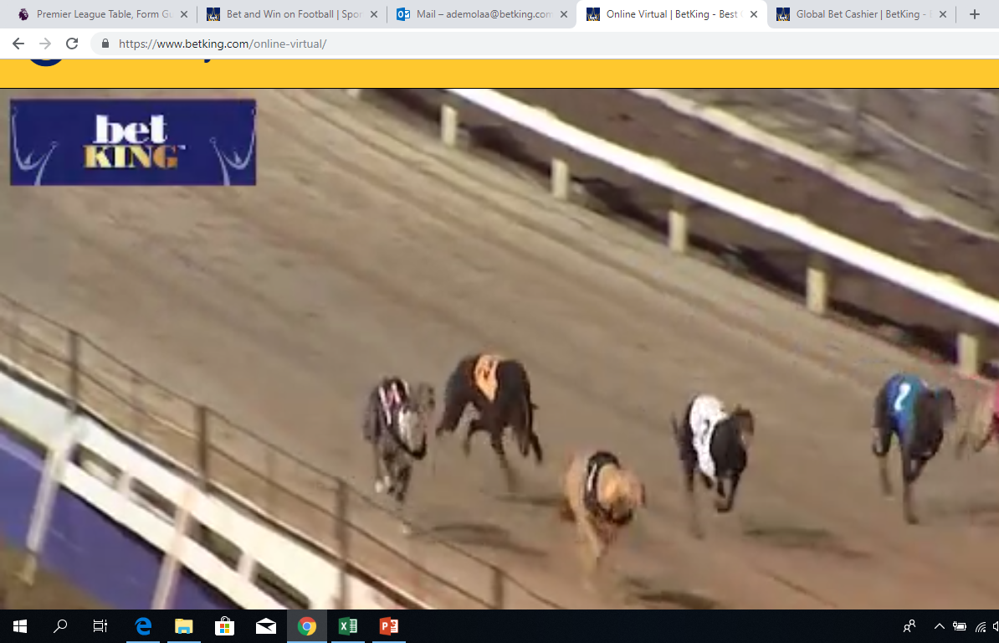
GREYHOUND

Slide 2
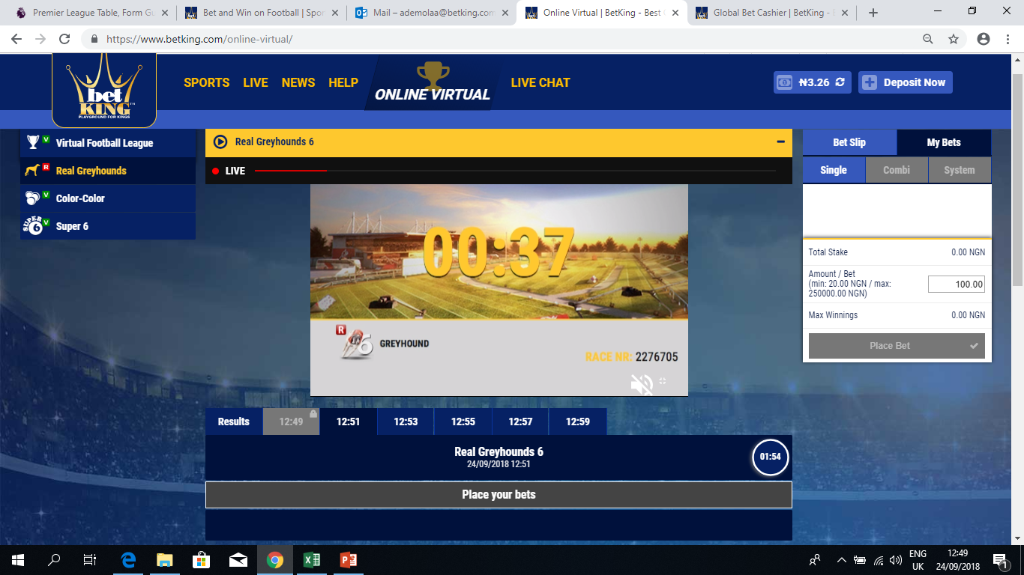
GREYHOUND INTERFACE (BEGINING OF EVENT)
1
The Greyhounds beginning of event interface has the following features:
1 – The scree that displays the dog racing event
2 - This shows the countdown of a new race
3 – This shows the countdown to the start of a new event
2
5
4 – This is the bar contains the tabs for results of past event and tab for time of current and future events
5– This shows the Bet slip
4
3

Slide 3
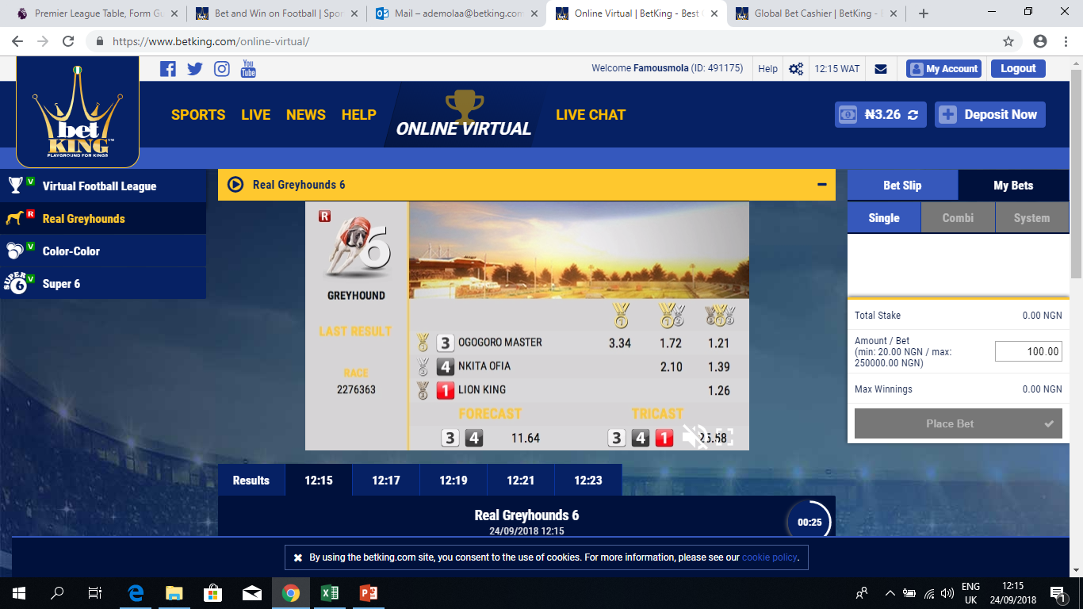
GREYHOUND INTERFACE (END OF EVENT)
The Greyhounds end of event interface shows the result of the event

Slide 4
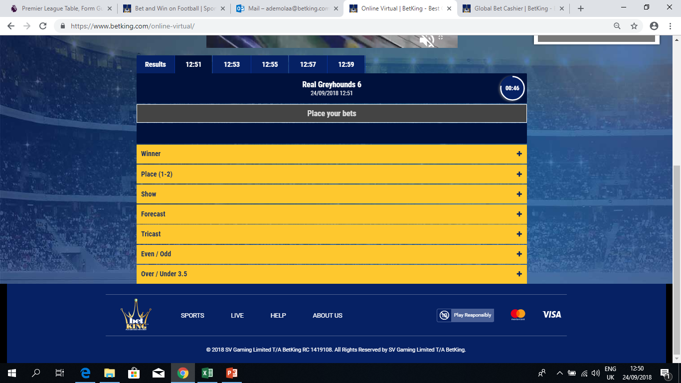
MARKET PANELS
The market panel shows the different market options which include
1.) Winner – to predict the exact winner
2.) Place (1-2) – to predict the dog that will either come 1st or 2nd in the race
3.) Show – to predict the dog that will either come 1st, 2nd, or 3rd in the race.
4.) Forecast – To predict the exact dogs that will come 1st and 2nd in the race.
5.) Tricast – to predict the exact dogs that will come 1st, 2nd and 3rd in the event.
6.) Even/Odd –To predict if the odd number will come first or the even number.
7.)Over/Under 3.5 –To predict if the winning number will be over (4,5,6) 3.5 or under (1,2,3) 3.5

Slide 5
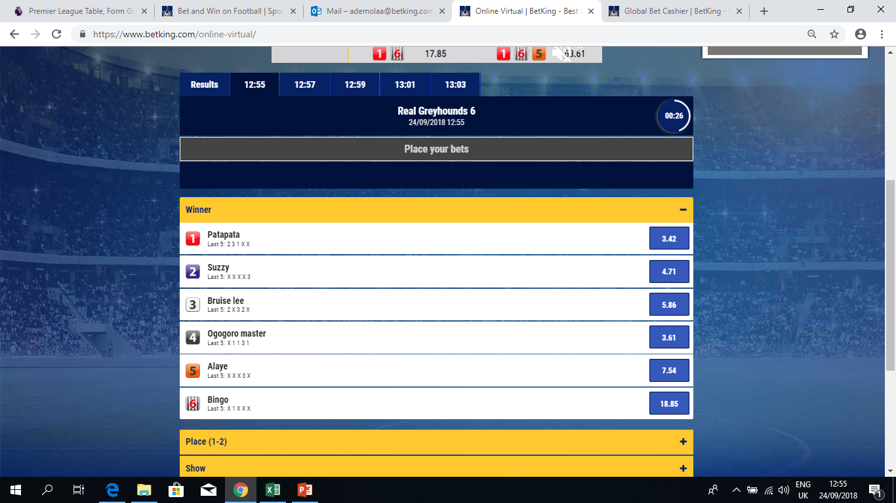
MARKET PANELS (WINNER)
The Winner market panel provides the winning odds for the 6 different dogs and their performance in their last 5 events to aid punters in making their predictions.
To predict the winner, simply click on the odds of the dog number that will win.

Slide 6
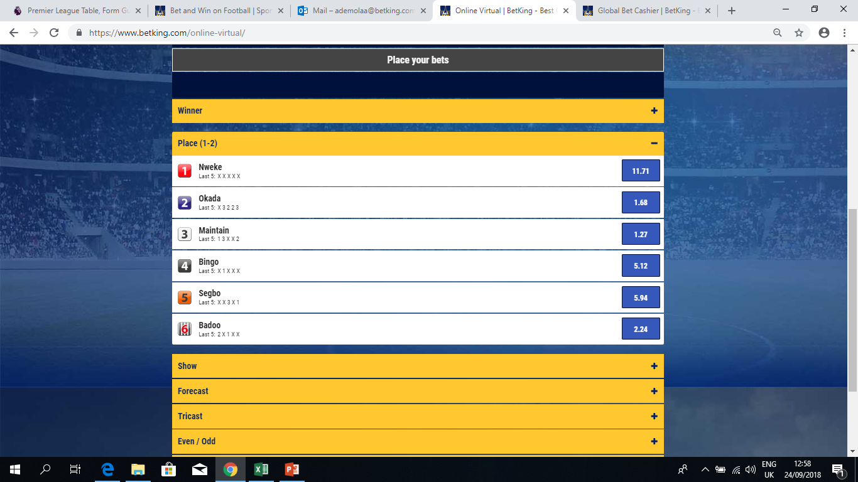
MARKET PANELS (PLACE 1-2 POSITION)
The Place (1-2) market panel provides the winning odds for the 6 different dogs and their performance in their last 5 events to aid punters in making their predictions.
To predict on the dog that will come 1st or 2nd in the event, simply click on the odds of the dog number that will win.

Slide 7
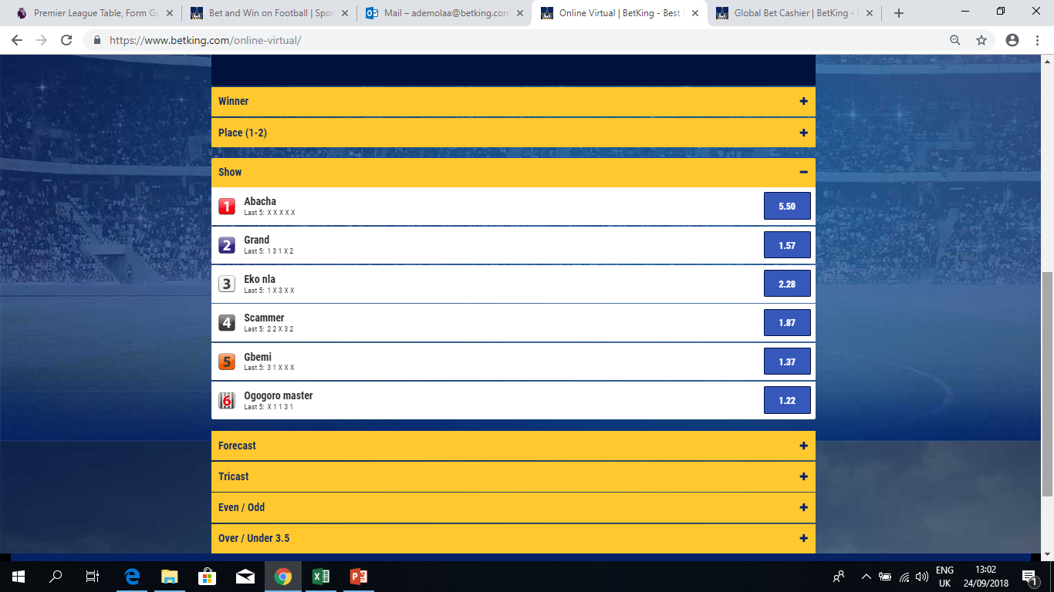
MARKET PANELS (SHOW)
The Show market panel provides the winning odds for the 6 different dogs and their performance in their last 5 events to aid punters in making their predictions.
To predict on the dog that will come 1st , 2nd or 3rd in the event, simply click on the odds of the dog number that will win.

Slide 8
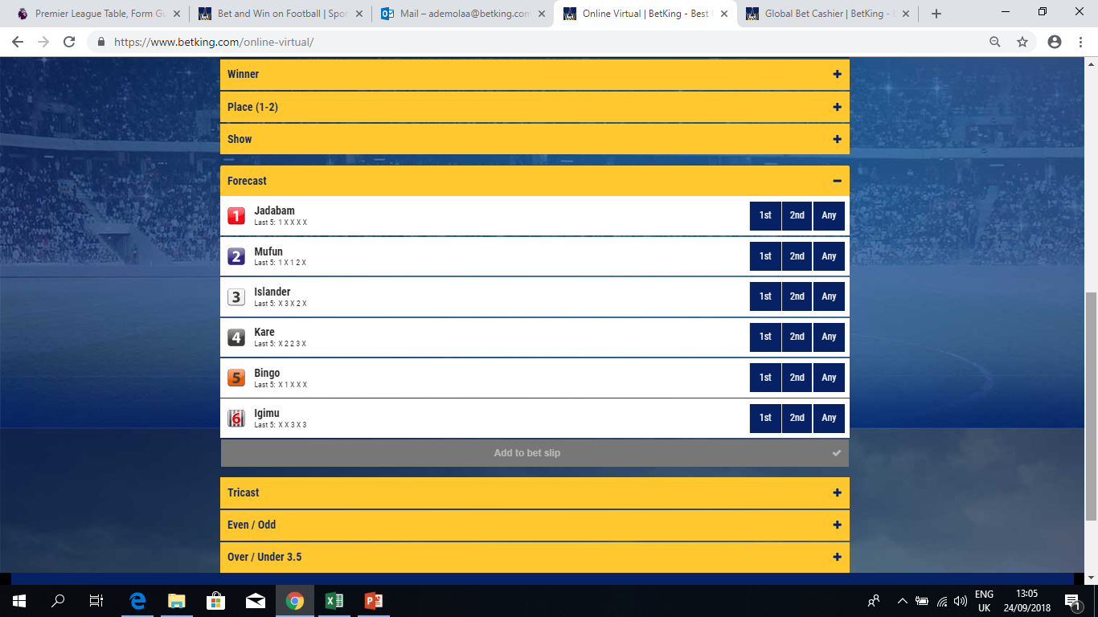
MARKET PANELS (FORECAST)
The Forecast market panel provides the winning odds for the 6 different dogs and their performance in their last 5 events to aid punters in making their predictions.
To predict on the exact dog that will come 1st , click on 1st
To predict the exact dog that will come 2nd, click on 2nd .
Alternatively click on any for the dog you are predicting to come 1st or 2nd .

Slide 9
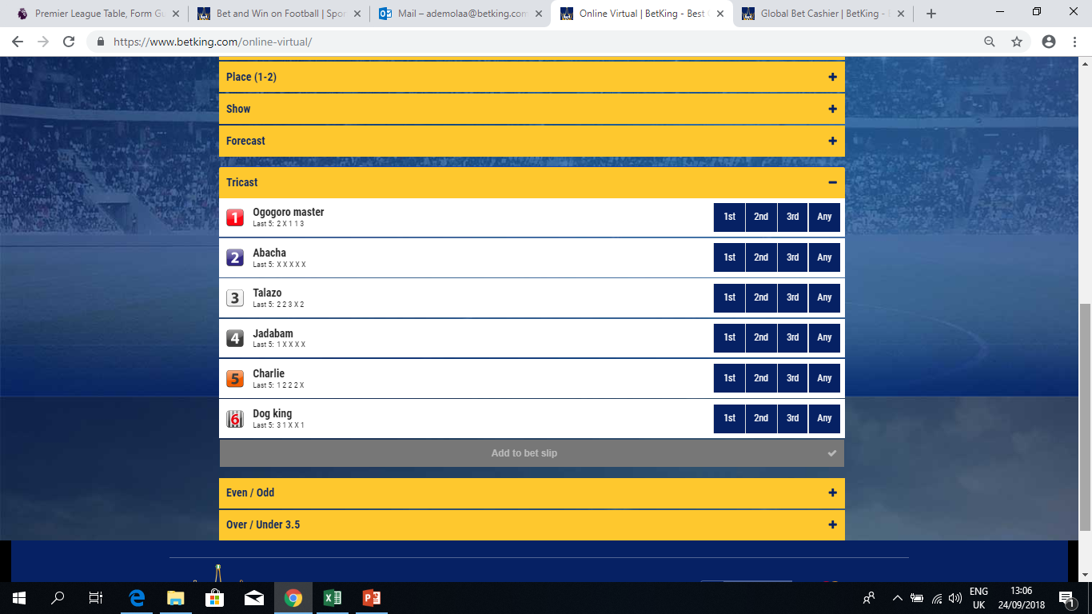
MARKET PANELS (TRICAST)
The Tricast market panel provides the winning odds for the 6 different dogs and their performances in their last 5 events to aid punters in making their predictions. It gives provision for punters to predict on the exact dogs that will come 1st, 2nd and 3rd.
To predict on the dog that will come 1st , click on 1st
To predict dog 3 to come to 2nd, click on 2nd .
To predict dog 2 to come to 3rd, click on 3^{rd.}
To predict that a dog will come either 1st , 2nd or 3rd, click on any

Slide 10
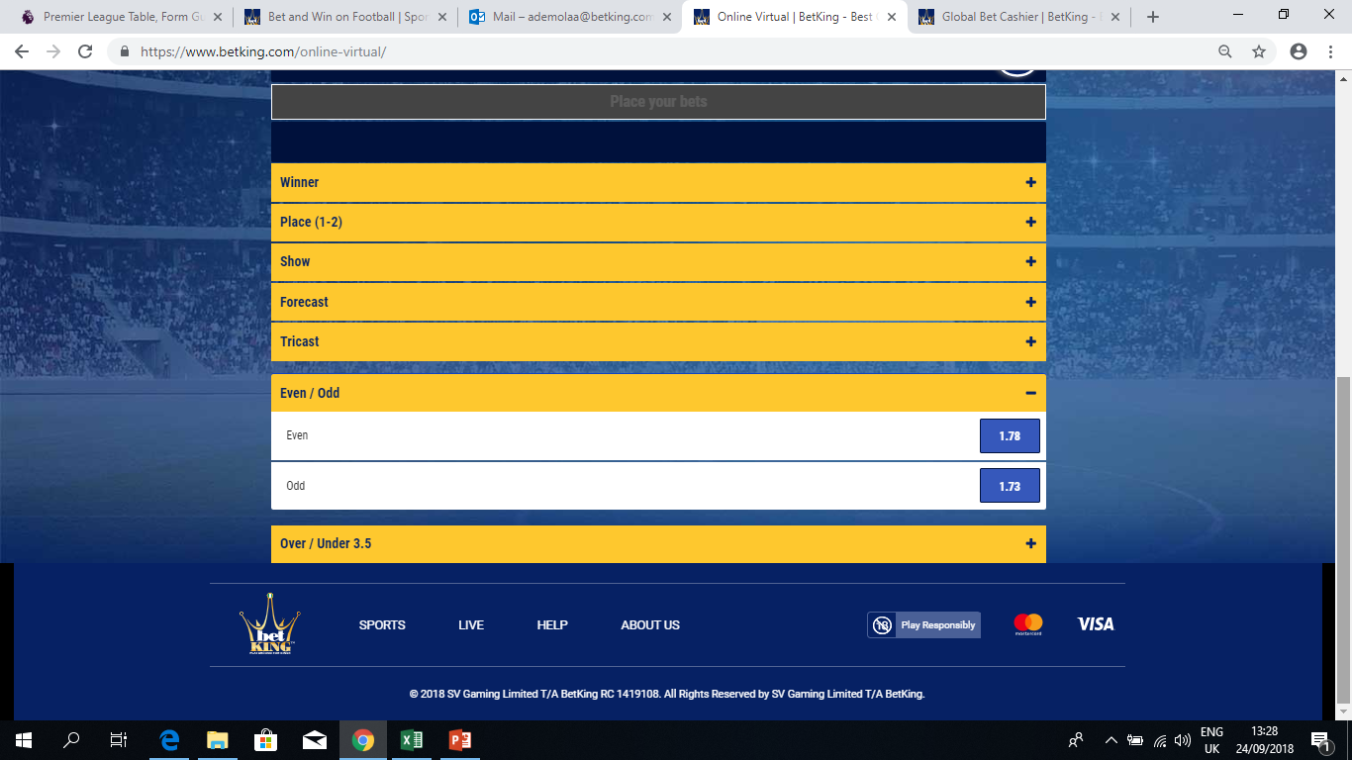
MARKET PANELS (EVEN / ODD)
The Even/Odd market panel provides the option of predicting if the number of the winning dog will be odd or even.
To predict that the number of the winning dog in the event will be odd, simply click on the odds of the odd option.
To predict that the number of the winning dog in the event will be even, simply click on the odds of the even option.

Slide 11
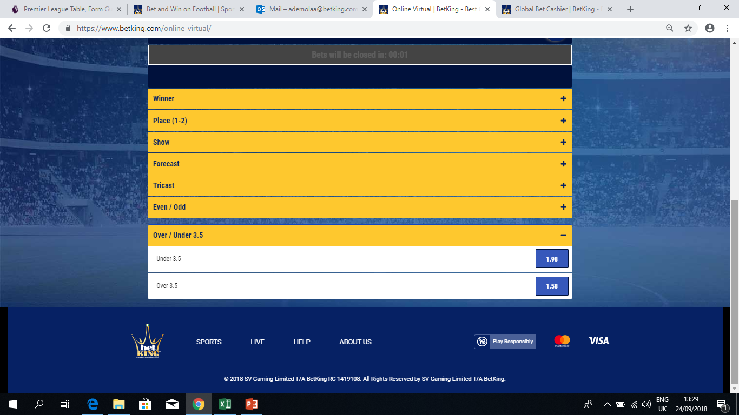
MARKET PANELS (OVER / UNDER 3.5)
The Over/Under 3.5 market panel provides the option of predicting if the number of the winning dog will be over 3.5 or under 3.5.
To predict that the number of the winning dog in the event will be over 3.5, simply click on the odds of the over 3.5 option.(4,5,6,)
To predict that the number of the winning dog in the event will be below 3.5, simply click on the odds of the under 3.5 option.(1,2,3)

Slide 12
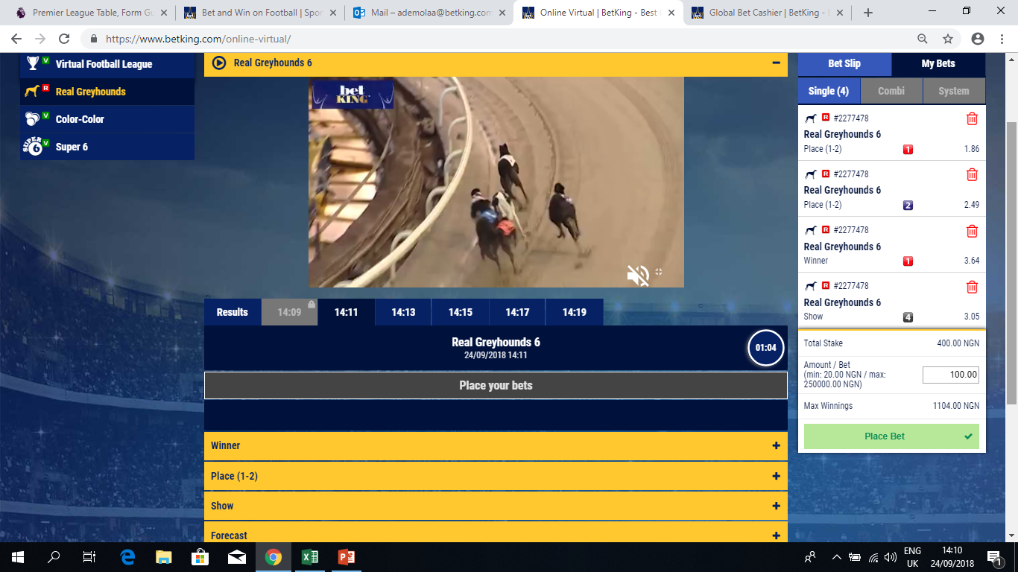
PLACE BET PANEL
The Place Bet panel shows the bet slip of the predictions a punter has made
After selecting or making predictions, you enter the amount to stake and click on Place Bet to complete the process.

Slide 13
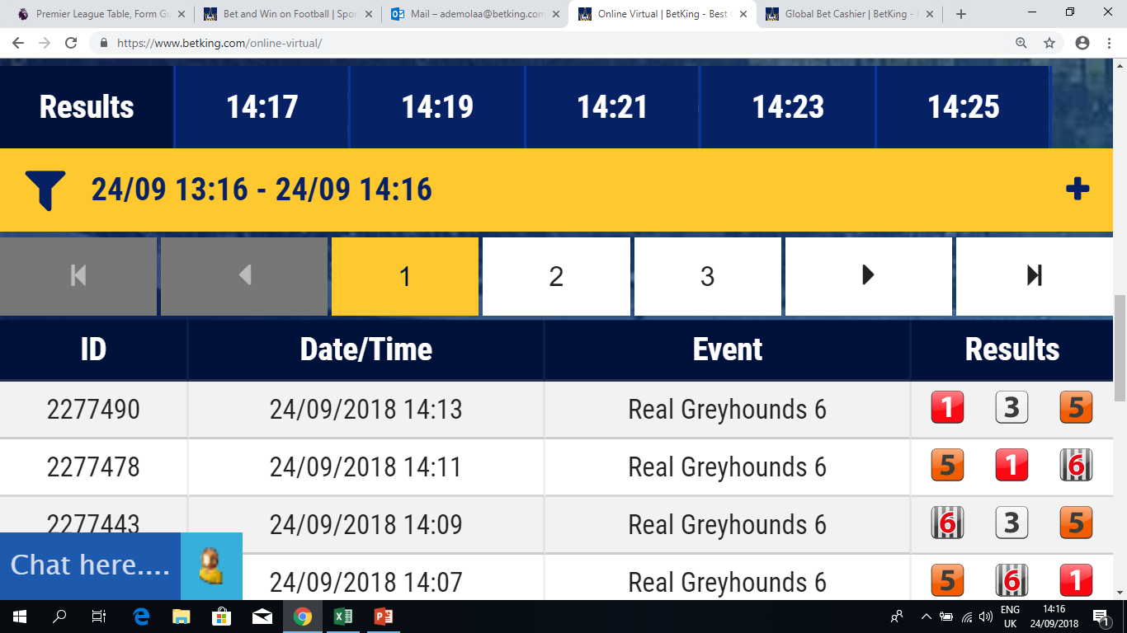
RESULTS / EVENT TIME PANEL

Slide 14
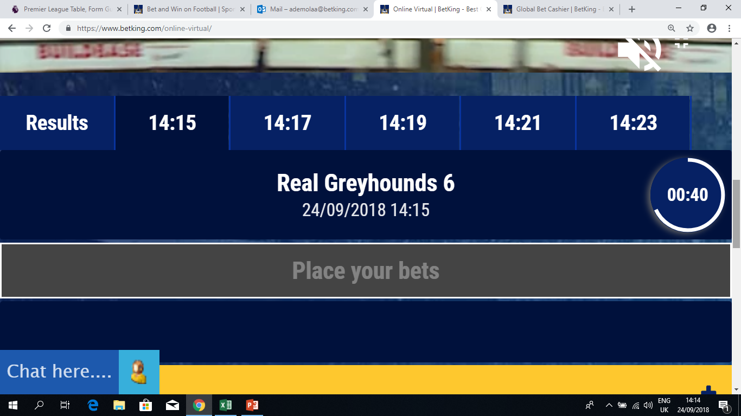
RESULTS / EVENT TIME PANEL

